Slide 1


IndustriAI Hackathon 2025
REDEFINING CREDITWORTHINESS: REAL-TIME RISK INSIGHTS WITH ALTERNATIVE DATA
Problem Statement Code: Real-Time Credit Risk Assessment Using Alternative Data
Team Name: Quantum Coders
Institution Name: Sri Jayachamarajendra college of Engineering
Github : https://github.com/KChandraSekhar265/CreditScore
MEMBERS:
K Chandra Sekhar
Likhith K
Kushal S
Suhas Rajesh

Slide 2

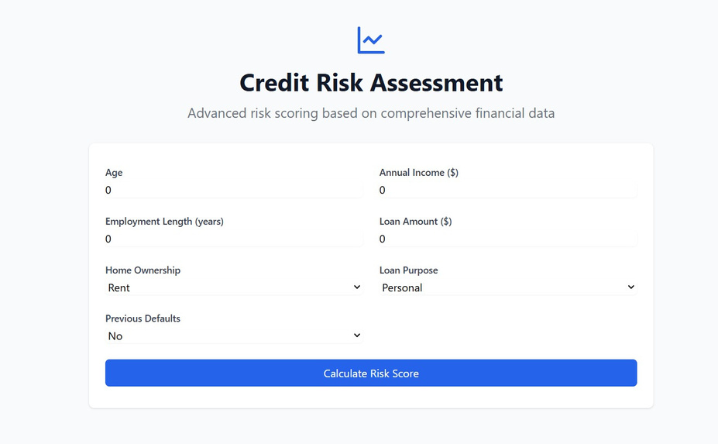

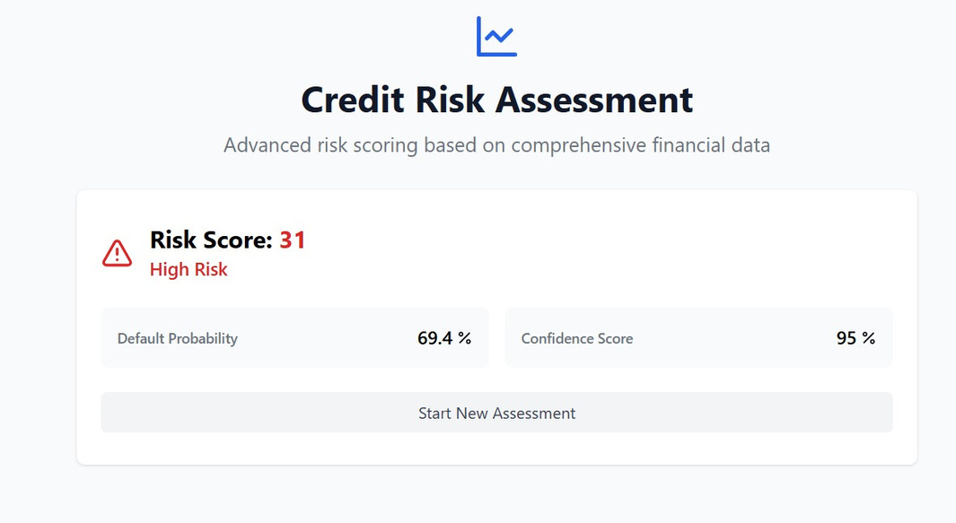

PROTOTYPE

Slide 3
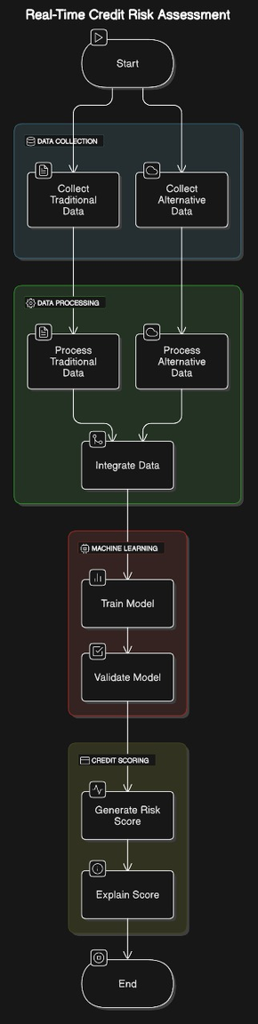
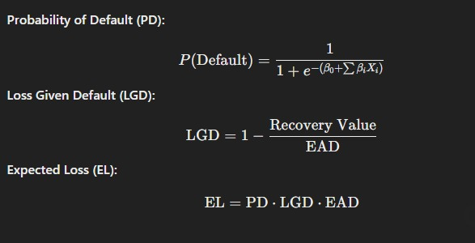
Credit Score Calculations:
Traditional Data: Credit scores, debt levels, and income
Alternative Data: Social media sentiment, utility payment records, and spending behavior.
Metrics: Evaluate model performance using metrics like Accuracy, Precision, Recall, and F1-Score. Visualize results through a confusion matrix or AUC-ROC curve.
Transparency: Ensure the model is explainable (using SHAP values or feature importance), fair, and compliant with data privacy regulations like GDPR.

